Slide 1
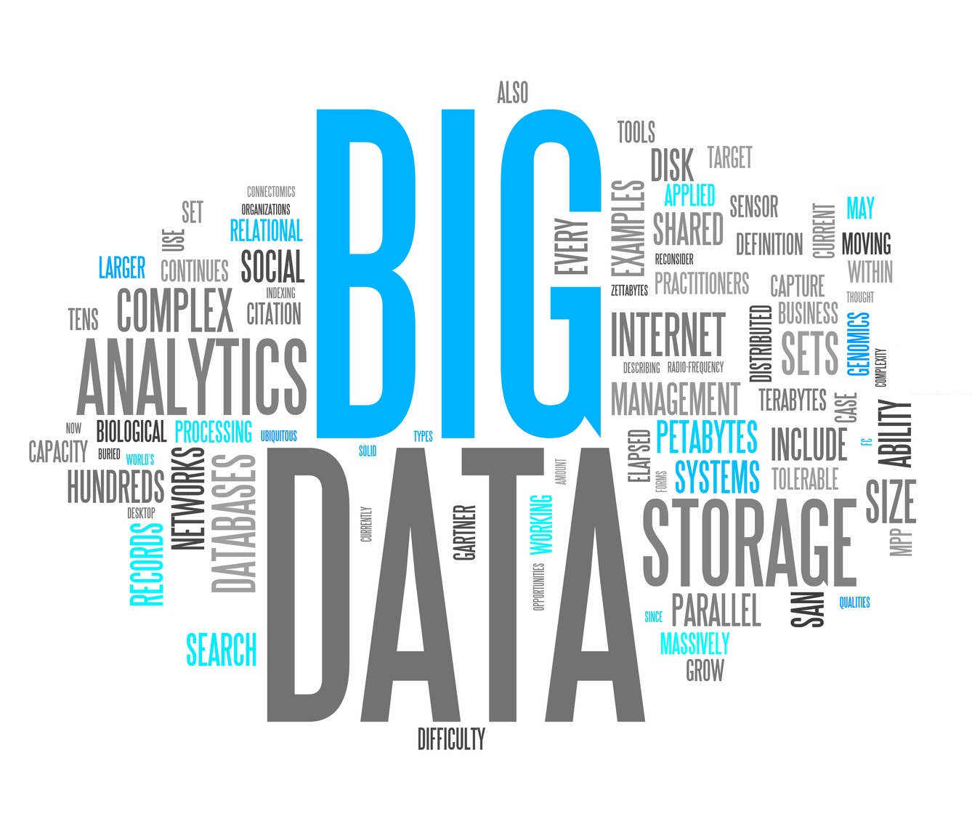
Introduction and History
0. By the feeling
1. Emergence of Statistics
2. Data Analytic and Storage with computers
3. Relational Database and Large Data Centers
4. Big Data Analytics
Source:
1. https://www.linkedin.com/pulse/brief-history-big-data-everyone-should-read-bernard-marr
2. https://www.flydata.com/blog/a-brief-history-of-data-analysis/
3. https://www.sas.com/en_us/insights/analytics/big-data-analytics.html#modal1

Slide 2
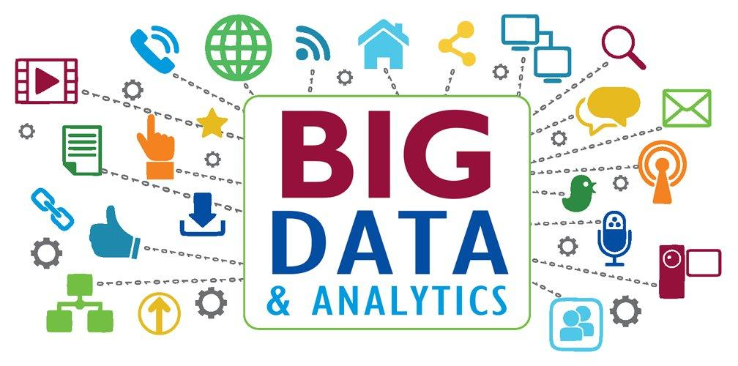
Big Data Analytics
1. Data management
2. Data mining
3. Hadoop
4. In-memory analytics
5. Predictive analytics
6. Text mining
7. other modern technologies
hidden patterns
correlations
other insights
quick and efficient
Source:
1. https://www.sas.com/en_us/insights/analytics/big-data-analytics.html#modal1

Slide 3
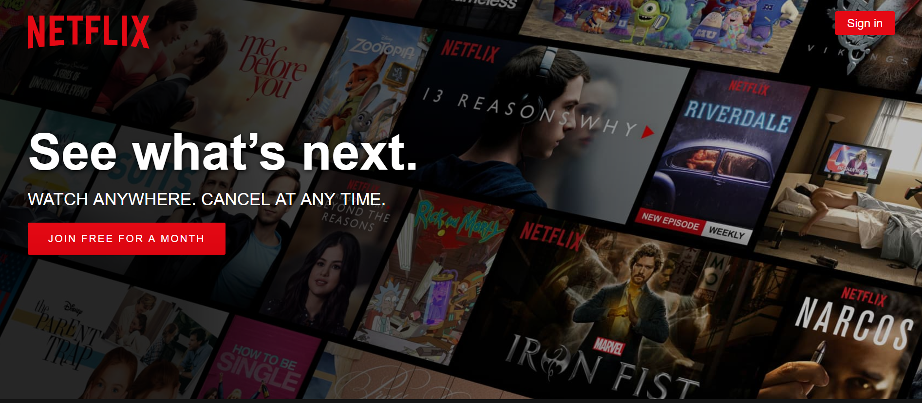
Netflix
American entertainment company
streaming media
video-on-demand online
over 98 million subscribers worldwide
Source:
1. https://www.netflix.com/au/
2. http://files.shareholder.com/downloads/NFLX/4303980673x0x937576/7DAD8A22-F8FE-4339-A534-4A851A5C68E5/Q117ShareholderLetterV2FINAL.pdf
3. https://blog.kissmetrics.com/how-netflix-uses-analytics/

Slide 4
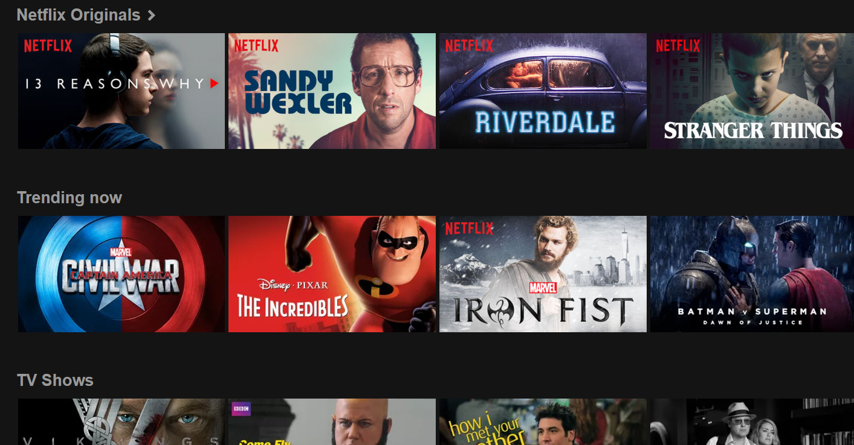
Netflix - Keep Old Subscribers
Add new content
Licensing movies from studios
Big Data Analytics
Know what people like to watch
Netflix may track
The details of the contents you watch(type, director, actor, etc)
When you pause, rewind, or fast forward
What day you watch content
The date you watch
What time you watch content
Where you watch (zip code)
Source:
1. https://www.netflix.com/au/
2. http://files.shareholder.com/downloads/NFLX/4303980673x0x937576/7DAD8A22-F8FE-4339-A534-4A851A5C68E5/Q117ShareholderLetterV2FINAL.pdf
3. https://blog.kissmetrics.com/how-netflix-uses-analytics/

Slide 5

Netflix - Attract New Subscribers
Create content
$100 million dollars to make the show:
House of Cards
With big data analytics
•A lot of users watched the David Fincher directed movie The Social Network from beginning to end.
•The British version of “House of Cards” has been well watched.
•Those who watched the British version “House of Cards” also watched Kevin Spacey films and/or films directed by David Fincher.
Source:
1. https://www.netflix.com/au/
2. http://files.shareholder.com/downloads/NFLX/4303980673x0x937576/7DAD8A22-F8FE-4339-A534-4A851A5C68E5/Q117ShareholderLetterV2FINAL.pdf
3. https://blog.kissmetrics.com/how-netflix-uses-analytics/

